Slide 1

The Economic Contribution of Aurora
Key Findings
  March 2026

Slide 2
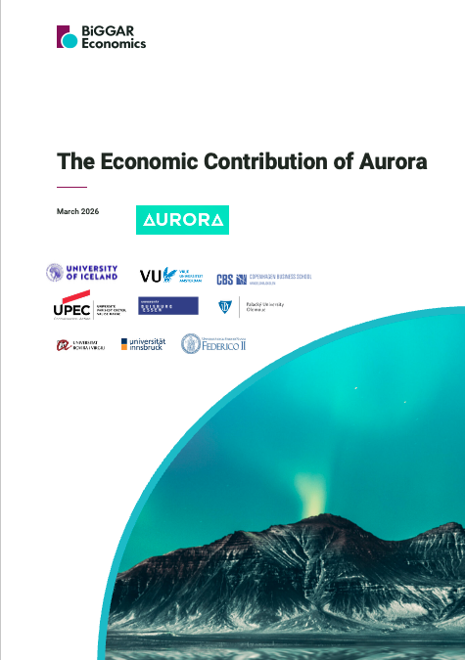
Agenda
    Key Findings
    Approach & Methodology
    Learning
    Valorisation
    Core
    Student
    Value Added
    Total Contribution

Slide 3
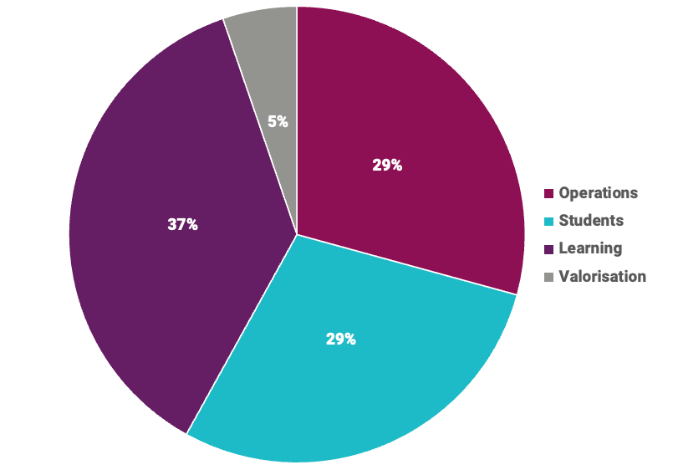
Key Findings
In 2024, Aurora members collectively generated €21.1 billion Gross Value Added (GVA) for the European economy, supporting 165,000 jobs.
The total contribution represents the aggregate power of the Aurora members and is comprised of:
    €6.2 billion GVA and 67,000 jobs from operations (core and tourism)
    €6.0 billion GVA and 88,000 job from students (spending, part-time working and volunteering)
    €7.7 billion and 4,000 jobs from learning (graduate productivity, professional education and student internships)
    €1.1 billion GVA and 6,000 jobs from valorisation (licensing, start-ups & spin-outs, services to businesses, science parks and incubators)
The nine universities that form Aurora are in their early stages as operating as a network, yet already evidencing collaboration, student and staff mobility, and income leverage as a result. Over the long-term, added value benefits can be expected to increase.

Slide 4
Approach & Methodology
GVA and employment contributions were estimated using Input-Output methodology.
Sources of Impact:
    Learning (Graduate Productivity, Professional Education and Student Internships)
    Valorisation (Licensing, Spin-outs & Start-ups, Services to Business, Science Parks and Incubators)
    Operations (Core and Tourism)
    Students (Spending, Part-time Working and Volunteering)
Data Gathering:
    Request sent to all members for the same data, which were aggregated to give the total for Aurora.
    Data gaps filled based on averages from the rest of Aurora, information from universities’ websites and financial accounts, and Eurostudent.
Other Data Sources:
    Eurostat (e.g., tourism trips and spend, VAT rates, sectoral university-business collaboration)
    Eurostudent
    OECD (e.g., Input-Output Tables and graduate productivity)
    Previous experience with European university networks
Study Area:
    Europe (European Economic Area + Iceland)
Economic Contributions:
    Direct: profit + staff costs from an organisation’s activity
    Indirect: supply chain spending effect
    Induced: staff spending effect.
    The figures presented represent the aggregate power of the Aurora members.

Slide 5

Learning
  Graduate Productivity
  Professional Education
  Student Internships

Slide 6

Graduate Productivity
Total Contribution:
€7.7bn GVA
What is this Contribution?
Having a university degree helps graduates to find a job that is aligned to the course they studied, and tends to result in higher wages than if they did not have the degree
Over graduates’ working lifetime, this premium wage leads to higher earnings, resulting in greater spending and taxes paid
Drivers of Contribution
The number of graduates by degree type and subject area
The returns to different qualification levels.
Aurora Assumptions
59,880 graduates in 2024:
  50% of which were Bachelors’ degrees
  45% Masters
  4% Doctorates
Majority of degrees were in social sciences, business and law

Slide 7

Professional Education
Total Contribution:
€134m GVA
200 Jobs
What is this Contribution?
Aurora provides professional education courses that align with changing workplaces and technological innovation
Businesses and organisations enter their workers onto such courses as they believe it will generate benefits, such as increased productivity, over the long-term
Drivers of Contribution
Income received
Aurora Assumptions
Income of €16 million in 2024
Every €1 spent on professional education generates €3.40 GVA in direct economic benefit to businesses

Slide 8
Student Internships
Total Contribution:
€236m GVA
3,600 Jobs
What is this Contribution?
As part of their university course, some students participate in internships in organisations aligned to their studies
In addition to students gaining practical experience, this also benefits the organisations as they have additional capacity for operational tasks and can benefit from the ideas of university students – resulting in increased productivity
Drivers of Contribution
Number of students doing an internship
Aurora Assumptions
15,380 students undertook internships in 2024

Slide 9

Valorisation
Licensing
Spin-outs & Start-ups
Services to Businesses
Science Parks and Incubators

Slide 10
Licensing
Total Contribution:
€26m GVA
500 Jobs
What is this Contribution?
Aurora members develop intellectual property and technology as part of their research and development activity
This is often licensed to other companies – giving them the legal right to use it, increasing the turnover and economic activity supported from the licensed property
In turn, income is received by Aurora members in terms of royalty payments
Drivers of Contribution
Value of income received by Aurora members
Aurora Assumptions
€1 million received in royalties by Aurora members in 2024
95% of the licence holders are based in Europe

Slide 11
Spin-outs and Start-ups
Total Contribution:
€196m GVA
2,400 Jobs
What is this Contribution?
With an experienced staff body and strong educational focus on entrepreneurship, Aurora members support their staff and students to start up, or spin out, their own businesses
This generates economic activity and supports employment – the realisation of which can be attributed to the support received from Aurora members
Drivers of Contribution
Number of spin-out and start-up companies supported by the company
Turnover and employment of the companies
Where the companies are based
Aurora Assumptions
240 spin-out and start-ups
Around 900 staff employed in the businesses

Slide 12
Services to Businesses
Total Contribution:
€701m GVA
1,300 Jobs
What is this Contribution?
Aurora members support productivity and innovation in businesses by providing services such as consultancy, commissioned research, and access to specialist equipment and facilities at the university
The outputs of these services enable businesses to increase productivity, develop new products and services, or improve existing ones
Drivers of Contribution
Value of income received by Aurora members
Aurora Assumptions
Income of €79 million received by Aurora members in 2024

Slide 13
Science Parks and Incubators
Total Contribution:
€181m GVA
2,100 Jobs
What is this Contribution?
Businesses can locate at science parks and incubators based at Aurora members
The main benefit of this is that they have close access to academics who support the development of businesses on-site
This supports the creation of productive, innovative, businesses, often with higher growth, and attracts more companies to locate on-site
Drivers of Contribution
Number of employees based on-site
Additionality of employment from being based at Aurora member science park/incubator
Aurora Assumptions
Estimated 1,930 additional employees based at Aurora members’ science parks and incubators

Slide 14

Operations
Core
Tourism

Slide 15
Core
Total Contribution:
€6.1bn GVA
65,200 Jobs
What is this Contribution?
The daily operations of Aurora members creates economic activity.
This includes the direct impact of the Aurora member existing, its role as an employer, the expenditure it makes in local supply chains and investment projects that generate high levels of spend and benefit the productivity and sustainability of the university in the long-term
Drivers of Contribution
Total income received
Total expenditure – including goods and services and staff wages and salaries
Location of suppliers
Number of staff employed
Value of spend on capital infrastructure
Aurora Assumptions
€4 billion received by Aurora members in 2024
€901 million spent on goods and services, of which 99% went to suppliers based in Europe
33,970 staff directly employed by Aurora members, receiving wages and salaries worth €2 billion
€29 million collectively spent on capital projects each year (e.g. buildings, machinery, IT equipment)

Slide 16
Tourism
Total Contribution:
€97m GVA
1,600 Jobs
What is this Contribution?
The Aurora members attract visitors to the local areas in which they are based who might otherwise not have visited – they then spend in the local economy
Visitors are attracted to the area as a result of attending conferences and events hosted by Aurora members, and visits to its staff and students from their friends and families
Drivers of Contribution
Number of visitors to conferences and events hosted
Number of visits made to staff and students by friends and relatives
Aurora Assumptions
34,040 visitors attended conferences and events organised by Aurora members

Slide 17

Students
Spending
Part-time Working
Volunteering

Slide 18
Spending
Total Contribution:
€2.8bn GVA
30,200 Jobs
What is this Contribution?
Whilst studying at an Aurora member, students spend in the local economy, supporting the activity and employment of local businesses
Drivers of Contribution
Number of full-time students
Where students live
Average monthly expenditure
Aurora Assumptions
274,410 full-time students enrolled at Aurora members in 2024
55% of which lived in rented accommodation, 30% in their family home, and 16% at university-owned accommodation
Average monthly expenditure of €874 for those living with parents, €1,236 for those living elsewhere

Slide 19
Part-time Working
Total Contribution:
€3.2bn GVA
58,100 Jobs
What is this Contribution?
During their studies, many students work part-time to support their income
This provides local businesses with an additional source of labour to carry out their operational tasks and generate turnover
Drivers of Contribution
Number of full-time students
Number of which work alongside their studies
Aurora Assumptions
274,410 full-time students enrolled at Aurora members in 2024
43% worked part-time alongside their studies

Slide 20
Volunteering
Total Contribution:
€34m GVA
What is this Contribution?
Many students at Aurora members also volunteer whilst studying, providing their time and skills for free
This enables the charities and organisations they volunteer in to have additional capacity for activities they may not otherwise be able to do – generating activity
Drivers of Contribution
Number of full-time students
Number of students that volunteer during their studies
Hours volunteered during the year
Aurora Assumptions
274,410 full-time students enrolled at Aurora members in 2024
21% of which volunteer each year
Average of 82 hours per year spent volunteering

Slide 21

Added Value
Being part of the Network has the potential to generate positive social and economic benefits for member universities, staff, students, graduates, and wider society.

Slide 22
Added Value of the Aurora Network
Joint education, student and staff mobility, and collaborative research.
The purpose of Aurora is to bring together nine research-intensive, European, universities to combine their collective academic expertise and knowledge to drive societal change.
By 2024:
    at least four members had received additional income from either their local or national government specifically for Aurora activities.
    at least 34 collaborative research projects were being undertaken
    over 500 members of staff were mobile across member universities
    almost 700 students across the member universities were on exchange from another member of Aurora
    over 30 Aurora events were held across the network.
Network additionality is the joint value created through the formation of a university network that would not occur if each university operated in isolation.

Slide 23

Total Contribution
Re-cap of Key Findings

Slide 24
Key Findings
In 2024, Aurora members collectively generated €21.1 billion Gross Value Added (GVA) for the European economy, supporting 165,000 jobs.
The total contribution represents the aggregate power of the Aurora members and is comprised of:
    €6.2 billion GVA and 67,000 jobs from operations (core and tourism)
    €6.0 billion GVA and 88,000 job from students (spending, part-time working and volunteering)
    €7.7 billion and 4,000 jobs from learning (graduate productivity, professional education and student internships)
    €1.1 billion GVA and 6,000 jobs from valorisation (licensing, start-ups & spin-outs, services to businesses, science parks and incubators)
The nine universities that form Aurora are in their early stages as operating as a network, yet already evidencing collaboration, student and staff mobility, and income leverage as a result. Over the long-term, added value benefits can be expected to increase.

Slide 25

Contact
Graeme Blackett
07890 998147
graeme@biggareconomics.co.uk

